Slide 1

GROUP-8
LIKITH - 2117033
ASHIL - 2117014
LYNEL - 2117066
ANTONY - 2117010

Slide 2





FARMER
MIDDLE-MAN
TRANSPORTER
CUSTOMER
MANDIS

Slide 3




PROBLEMS
OLD FARMER
NO STABLE INCOME
UNUSED FARMING LAND

Slide 4

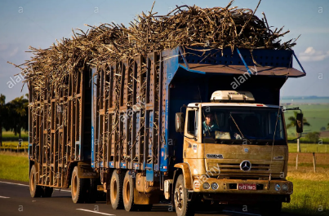
PROBLEMS
Soil pollutants
Transportation problems

Slide 5
Current system
Mono Croping.
Fragmented Land.
Most Farmers plant their crop during monsoon times an rest of the time land will be vacant.
Some Land Owners are away From their land so the land will be vacant.
Farmer(producer)) -> Middle man -> Mandi/Other Shop/Senior Man -> Mandi ->Auction->Company/Other owners-> Small shops->Customers.

Slide 6
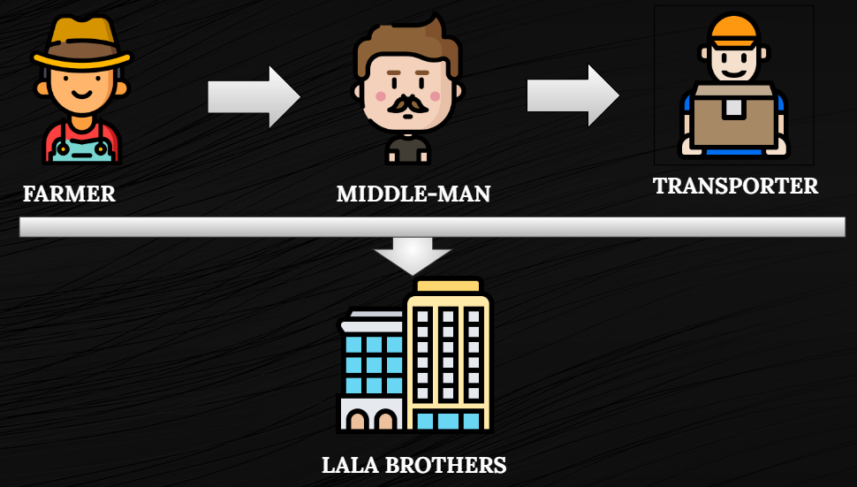
SOLUTION

Slide 7


FIND THE UNUSED LAND
REGISTRATION
MONTHLY WAGES

Slide 8


PROVIDING Monthly WAGES
FARMER

Slide 9
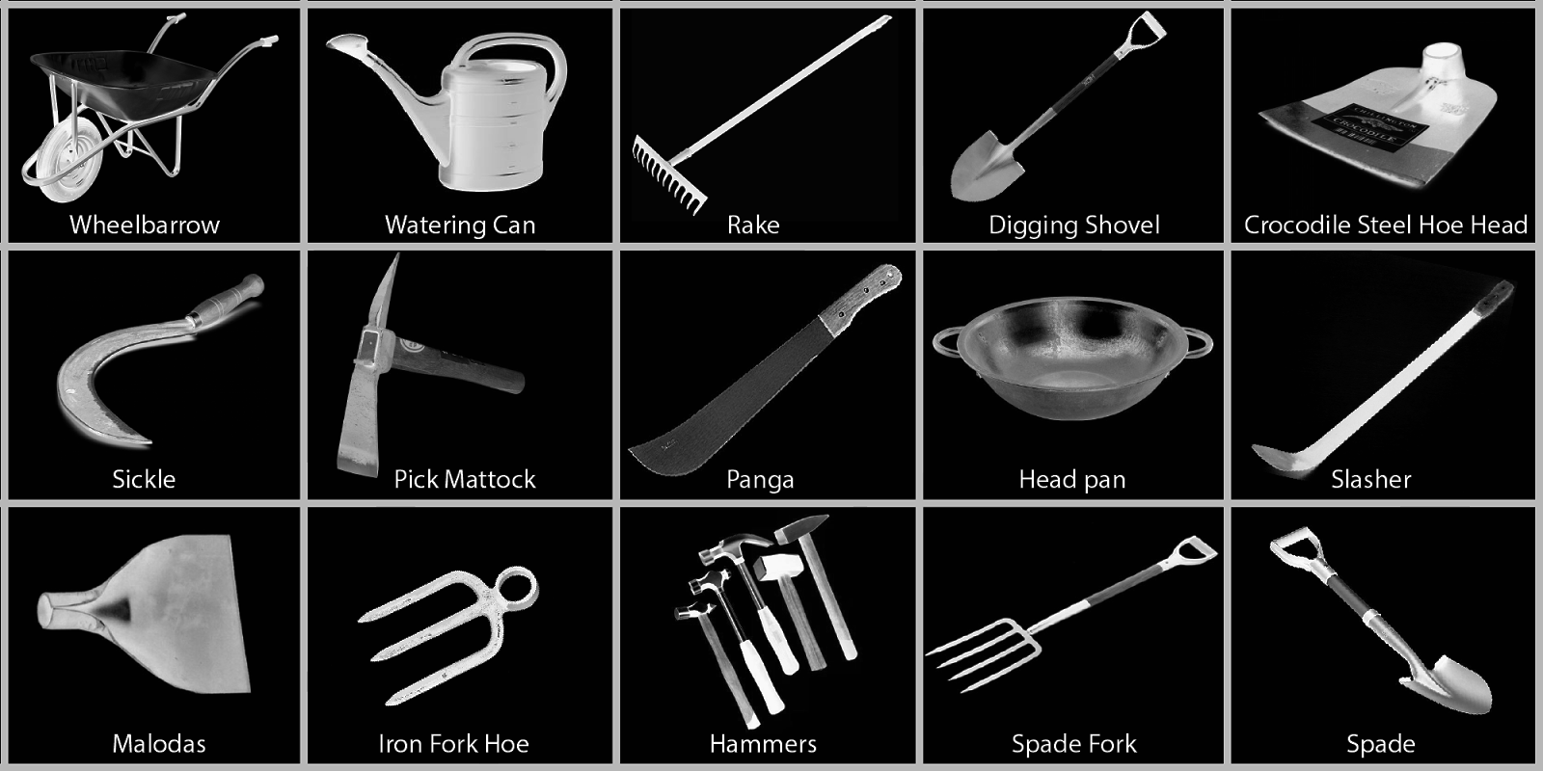

BENEFITS
STABLE INCOME
PROVIDING EQUIPMENT

Slide 10

COMPANY LOGO

Slide 11
Our business model
Search for the vacant field and Negotiating with its owner.
If he is willing to work with us –
We will first Register him in our group and give him his identity card
We will provide him neccessary items depending on conditions and also human power to help him
Money based on profit will be shared with him/Partiular amount of money is shared
If he gives only his land and not willing to work
We register him and give him his identity card
We grow crops and sell but some amount of money will provided to him…Instead of wasting his vacant land this is better :)

Slide 12
Market analysis:Our customers
Buyers,Food Industries,Our own farmers.
To Manage their lands,To provide them a stable income
Solution
Multiple Crops
Modernization in agriculture
Farmers Education is vital
Crop Insurance
Better Water Management

Slide 13
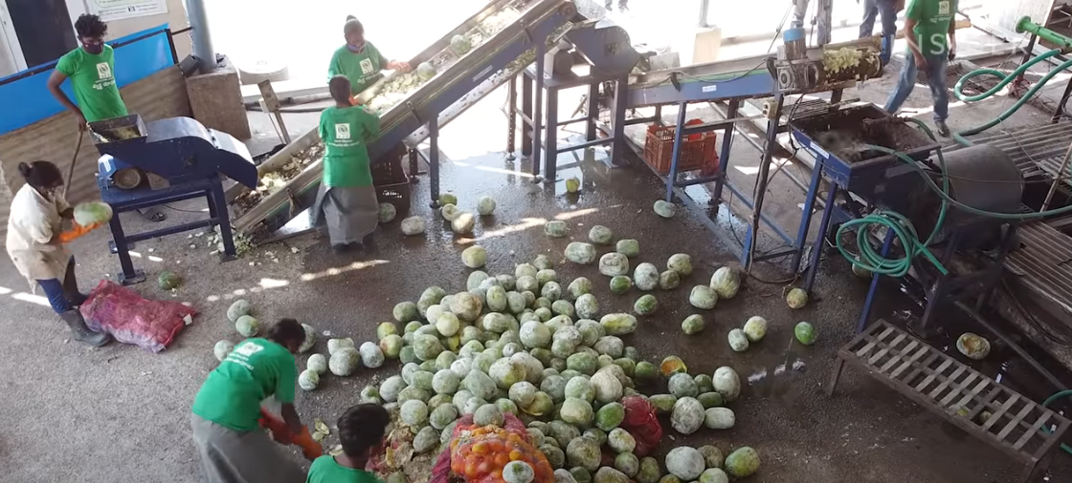
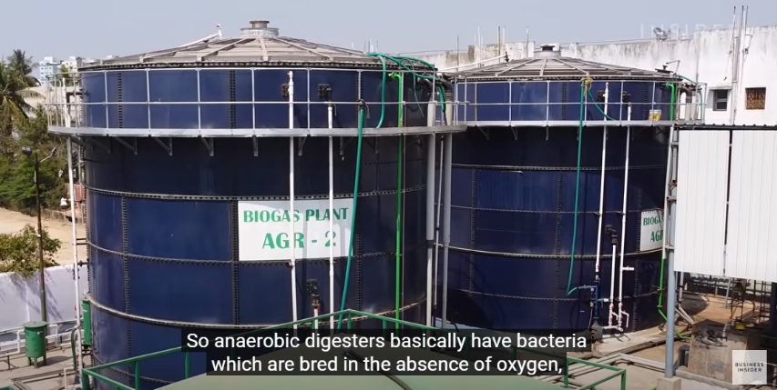
Goals and potential of the business and milestones
BIO GAS
Another by product of bio gas is fertilizer

Slide 14
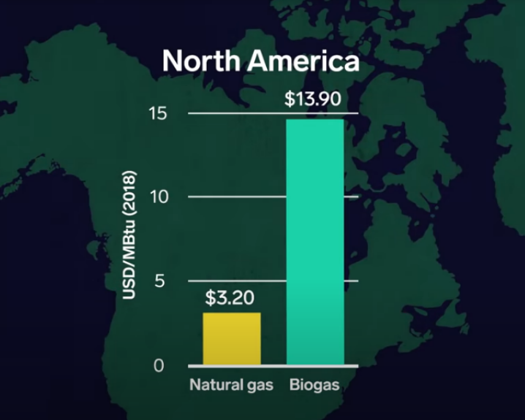
Price of Bio Gas

Slide 15
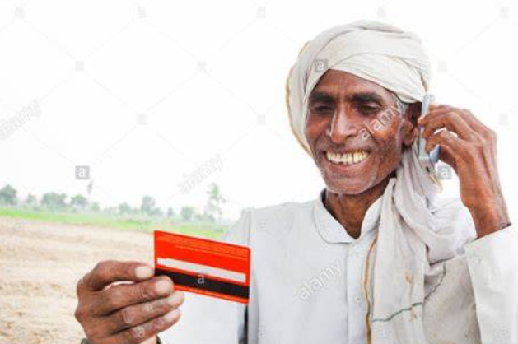
Uniqueness of product or service
Fresh vegetables to be sold
Residulas of bio gas to be used as fertilizer which enhances soil fertility
Soil testing
Concession for farmers who purchases crops from our shop but they have to show their id card

Slide 16
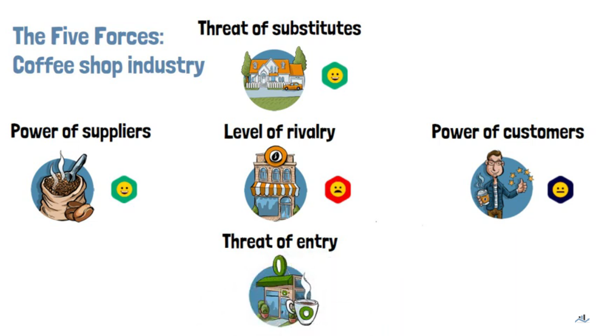
Market analysis
It is a broadly used model in business that refers to the five important factors that drive a firm's competitive position within an industry. By thinking through how each force affects you, and by identifying the strength and direction of each force, you can quickly assess the strength of the position and your ability to make a sustained profit in the industry.

Slide 17
Level of rivalry –If similar company is there it makes the company less attractive so unique plan
Power of consumers – less prize & quality is where the consumers go to purchase
Power of suppliers — Good raw materials should be takes from suppliers
Threat of substitutes – Other farmers can grow vegetables and sell it or consumer can grow vegetables in their home or field
Threat of entry – new compiters may arise.

Slide 18
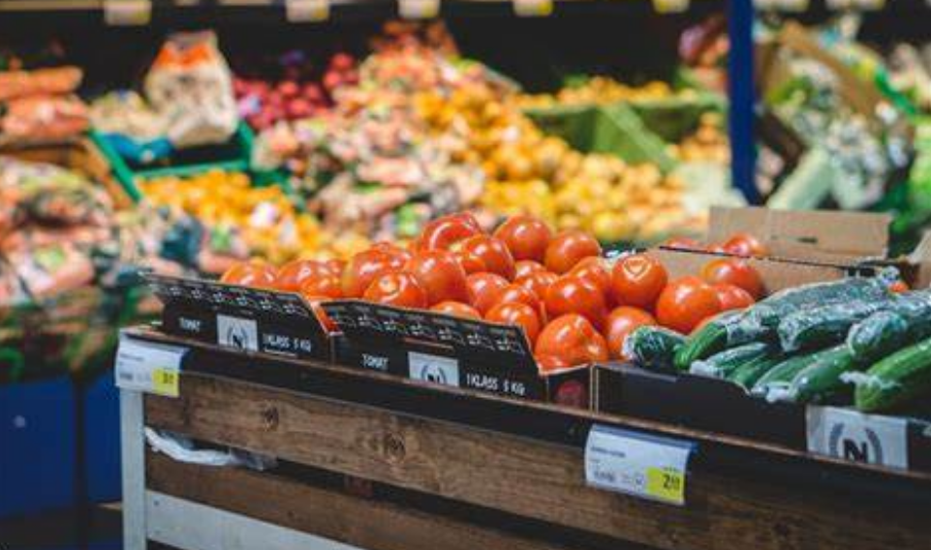
Pricing
Depends on buy and sell for vegetables
The average price of methane around the world is 1.44 U.S. Dollar per litre.

Slide 19

Advertising and promotions
Farmers are our advertisement because of the discount from the id card.
Google ads for farmers children to get know about our startups
Radio ads for those in village area
Paper ads
Meeting with farmers

Slide 20

Management
Legal structure – stock agreements
In a stocking agreement, a buyer agrees to purchase, and a supplier agrees to ship a certain amount of product throughout a set time. This arrangement allows companies to manage their inventory to avoid overstocking or running out of a product.

Slide 21

Employment agreements,
This Employment Agreement i.e. terms and conditions of employment is a contract for use when an Indian business hires a new employee. It can be used for a range of different employment types, including full time, part-time and fixed term.
This Agreement sets out all the terms of employment, including job duties, salary and benefits, work hours, confidentiality, annual leave and various other key terms.

Slide 22
Financial forecast
Cash flow/Revenue source
Vegetable,Fruits & Crops
Bio gas
Natural Fertilizer
Farmers who purchases our product

Slide 23

Funding the Growth / Scalability
As your business grows, your expenses may increase, requiring more financing.
Making growth more cost-efficient
Financing growth from profits
Attracting investors
Converting assets into growth
Finding financing

Slide 24

Startup India Scheme
must be a private limited company or a limited liability partnership
approval from the Department of Industrial Policy and Promotion (DIPP)
new firm and not older than five years turnover of the company should not exceed 25 crores

Slide 25

Benefits of Startup India Scheme
Tax Exemption
the startups registered under the Startup India scheme are exempted from tax
This exemption is provided for a period of the initial three years

Slide 26
Business Loans for Startups by the Indian Government
Bank Credit Facilitation Scheme
The repayment tenure of the scheme ranges between 5 years and 7 years but in special cases, it can be extended up to 11 years
Pradhan Mantri Mudra Yojana (PMMY)
Ranging between Rs.50,000 and Rs.10 lakh
Sustainable Finance Scheme
Loans ranging between Rs.10 lakh and Rs.1 crore can be availed
Repayment of loans seven years

Slide 27

MARKETING STRATEGIES

Slide 28



CAMPAIGN
TALKS
REFERRAL PROGRAMS
PAMPHLET

Slide 29

Building the A Team
It enables your team to share ideas and responsibilities, which helps reduce stress on everyone.

Slide 30

Building the A Team
PURPOSE:
Teamwork innovate faster, see mistakes more quickly, find better solutions to problems, and attain higher productivity.
Teamwork aims to increase productivity and performance for the benefit of the organization

Slide 31
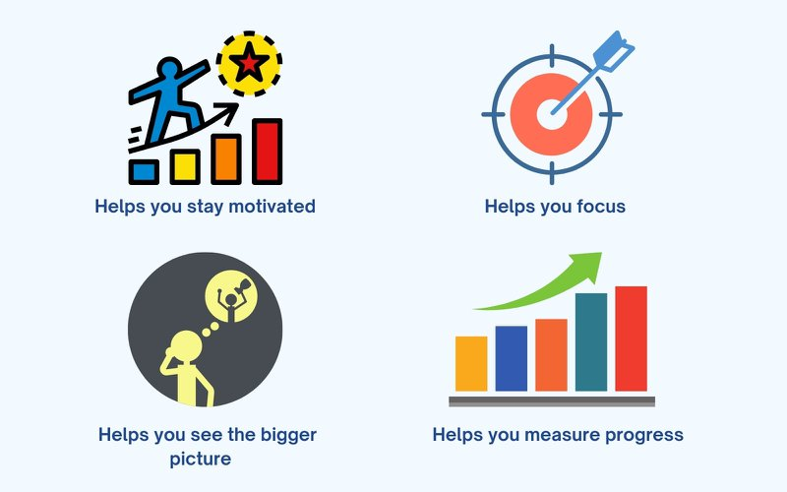
characteristics and qualities of a successful team
Goal Oriented
Goal-focused teams consistently track their goals
Better team collaboration
Increased productivity
More goals achieved

Slide 32

Importance Share accountability and ownership
Distributes responsibilities
Strengthens communication.
Encourages collaboration.
Increases innovation.
Promotes growth.

Slide 33

steps to building a successful and effective team
Set organization goals and start planning
Define the roles within your team
Promote individual development
Allow your team to take risks and experiment

Slide 34

Find a brand personality
A brand must have a personality, i.e. a set of distinctive features, for example, in communications, relations with consumers
It’s easier for a brand with an established personality to fight for the attention of the customer.

Slide 35

Maximize your visibility: website and social media
WEBSITE
Difficult to promote a product without a website.
The main idea is spreading the word. The website is the first people would look for when hearing about a new startup
Having a good website is a prerequisite for any kind of business nowadays

Slide 36

Maximize your visibility: website and social media
SOCIAL MEDIA
Easier to target younger audience.
building long-term relationships with customers and potential buyers.
Make your account engaging: write useful content, provide links, add pictures, and videos
Communicate. The meaning of social networks is in relationship-building. Communication in social networks is based on dialogue.

Slide 37
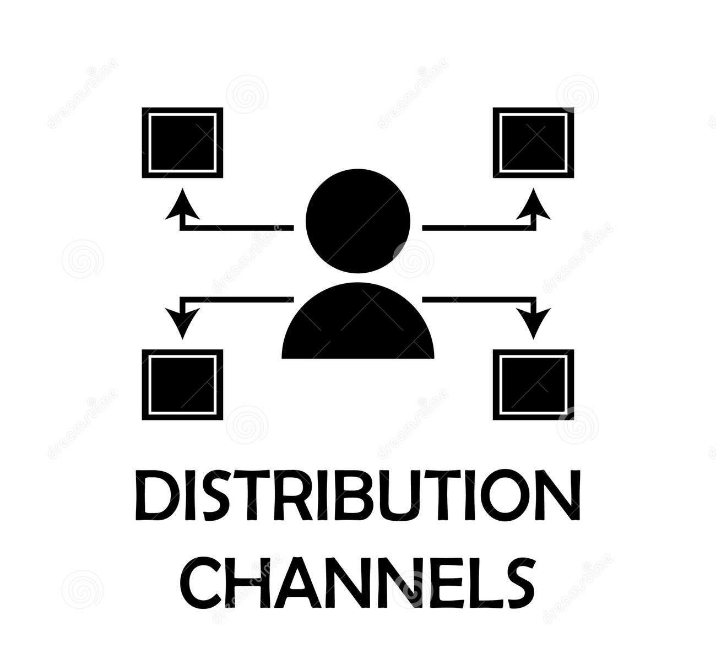
Channel Strategy :
Plan for moving a product or a service through the chain of commerce to the end customer.
Types of channel strategies
Direct sales
The simplest approach is the direct channel in which the vendor sells directly to the customer
Indirect sales
Vendors can also pursue sales via indirect channels involving one or more intermediaries. Indirect sales models include retail

Slide 38
Leveraging Technologies and Available Platforms
Data-driven farming: By analyzing and correlating information about weather, types of seeds, soil quality, probability of diseases, historical data marketplace trends, and prices, farmers will make more informed decisions.
High yield seeds: high yield seeds will be used in the farms.

Slide 39

HYDROPONICS
Hydroponics, a subset of hydroculture, is the method of growing plants without soil, using mineral nutrient solutions in a water solvent.

Slide 40

ALGAE FEEDSTOCK
Algae farmed in aquaculture sites can become a substitute for feedstock and fishmeal. Plus, algae is a more reliable source of
feedstock. given that its availability is not dependent on
catching fish. This provides producers greater control
Over costs and the ability to forecast future investment
or financial results thanks to the reduction of risk in
aquaculture farming operations.

Slide 41

DESERT AGRICULTURE AND SEAWATER FARMING
The King Abdullah University for Science and
Technology (KAUST) in Saudi Arabia is at the forefront
on desert agriculture: The Desert of research is seeking to:
identify microbes associated with plants growing in extreme heat, drought, and salt conditions;
identify the molecular mechanisms that enable plants to adapt to extreme environmental conditions induced by the microbial association:
use the appropriate rhizosphere partners to enhance plant stress tolerance and help increase crop food production in a sustainable way.

Slide 42

VERTICAL AND URBAN FARMING
Vertical farming is one answer to providing high-quality
produce sustainably. Vertical farming is the process of
growing food in vertically stacked layers, producing
food in challenging environments where suitable land
is unavailable. Associated with urban farming. it uses
soil, hydroponic, or aeroponic growing methods. The
process uses 95 percent less water, less fertilizer
and nutritional supplements, and no pesticides, while
boosting productivity.

Slide 43

DRONE TECHNOLOGY
Soil and Field Analysis
Crop monitoring
Crop Spraying
Irrigation

Slide 44



ONLINE PROMOTIONS
SOCIAL MEDIA PLATFORM
RUNNING ADS
SEO

Slide 45
Measuring your Progress
Benchmarking: The process used to identify, learn from and adapt better practices from other farmers to help improve farm performance.
Profit: The difference between money that comes in from the sales of a product and the money that goes out to produce it. Profit is used to measure the success of the farm business and is vital for its survival and growth.
Profitability: A measure of performance that shows how well the resources available to the farmer are used to generate income and profit.
Efficiency: Efficiency is the careful use of the resources available to the farmer. Efficiency can be either technical (producing the highest possible output from a given set of inputs) or economic (the financial returns from resources used).

Slide 46
Measuring your Progress
Step 1: Revisit Your Vision, Mission and Values.
Step 2: Review Your Business Plan and Goals.
Step 3: Analyze Your Finances.
Step 4: Ask Yourself, Does Your Brand Need an Update?
Step 5: Ask for Client Feedback.
Step 6: Evaluate Vendors.
Step 7: Check Your Marketing Plan’s ROI.
Step 8: Check Your Current Processes.

Slide 47
Legal Matters:
The following are the legal requirements that required to start a business in India.
Registration of a business entity: The first step is deciding the business structure and registering it. Some of the common business entities are Sole Proprietorship, One Person Company, Limited Liability Partnership, Partnership Firm, Private limited company, and Public limited company.
Name: One of the most important steps is deciding the name of the business as it refleacts the vision of the business. Check to see if the name you selected hasn’t been claimed by another entity.

Slide 48
Founders Agreement: Creating a founder’s agreement containing all the details regarding founding members of a business is a solid foundation of the business. As a result, the document serves as a contract that legally establishes the founders’ and company’s rights, ownership, obligations, dispute resolution, and other aspects.
Documents:The first step is to ensure that all of the necessary documents for registration are in order. Setting up a business in India necessitates a plethora of legal requirements and documentation.

Slide 49
Legal licenses and registrations: To conduct and run the business, there are few registrations and licenses required. Some of the general registrations include Shops and Establishments License, Permanent Account Number, GST registration, Income Tax registration, Bank Account, etc.
Taxation laws: In any kind of business, taxes play a crucial role. There are respective local taxes, state taxes and central tax that apply to different business sectors, therefore, knowledge of the tax regime with respect to one’s business sector is very important.
Labour laws: Labour laws regulate minimum wages, maternity benefits, gratuity and PF payments, laws relating to sexual harassment at workplace, etc.

Slide 50
Intellectual Property: Protecting the Intellectual Property rights are a very important aspect for enhancement of the business. Any new inventions, symbols, logos, brand name, etc., is to be registered which in turn helps in the recognition of the business among the competitors and enhances the Goodwill of the company.
Business policy: Another step that can help a business succeed is to develop a proper business policy. It’s something that keeps both employees and management on track. This makes achieving the desired targeted growth more easier.
Insurance: It is always safest to get insurance to safeguard your business from other potential threats. Business insurance can help one to protect the assets of your company.

Slide 51

Mentorship and Seeking Support
Mentor:
Mentors can be key to your business’s success by giving you insights from those who did it before you.
You'll receive guidance based on real-world experience, connections to other advisors, and physical resources from your mentors to aid in your development.
Aim to give as much as you receive, whether by picking up the tab or providing new strategies your mentor doesn't have experience in.

Slide 52
Advisors
A business advisor works with the company very closely on their strategy and advice them on various aspects, especially on product development, marketing, and finances. These three dynamics are crucial to every business.

